Slide 1


Smart Greenhouse Management System
Five Guys
Group members: Josua Louw (u24569772), Darius Erasmus (u24586189), Nico Theron (u23565722), Heindrich Jansen (u24711358), Frikkie Malan (u14439141)

Slide 2

CONTENT
01
02
System Overview & Class Diagram
Assumptions
03
04
Demo
Design Patterns

Slide 3


System Overview & Class Diagram
01
Plants move through stages automatically using timers and threads
Care tasks (water/fertilize) require waiting → staff get “busy”
Ensures the Chain of Responsibility is actually relevant
Staff execute tasks in parallel
Orders are constructed step-by-step
Plants and items stored in sections; traversed with an iterator
Mediator routes tasks between Customers, Caretakers, Sales Managers

Slide 4
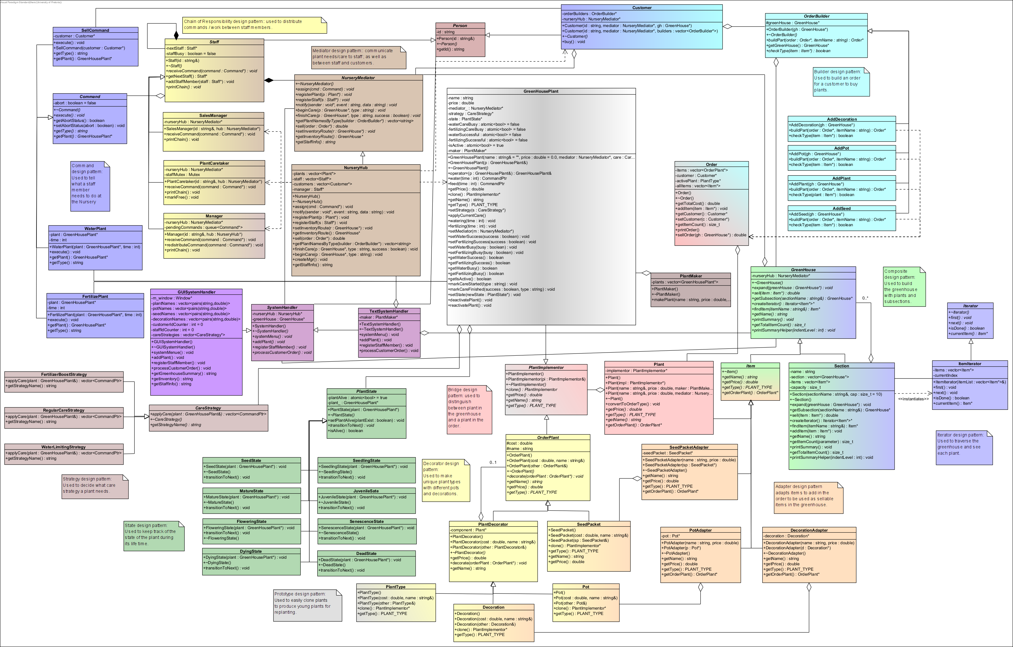
System Overview & Class Diagram
01

Slide 5
Assumptions
02
Order Restriction:
A customer will not buy multiple items with the same name in a single order (e.g., they may buy one sunflower and one tulip, but not two sunflowers in the same order).
Design-Pattern Focus:
The simulation prioritizes demonstrating design patterns, modular structure, and unit testing rather than a graphical user interface.
Plant Decoration:
A plant may be “decorated” with a pot or decoration at purchase time, forming a customized product.
Notes:
Before we move forward, let's establish our foundational assumptions. These will serve as the bedrock for our analysis and guide our approach to the challenges ahead. Understanding these assumptions now will help clarify our reasoning in subsequent discussions.

Slide 6
Assumptions
02
Concurrency Simplification:
Threads are used to simulate parallel plant care and state changes, focusing on correctness and race-safety. Full real-time scheduling and long-term persistence are out of scope.
Sellable Items:
Pots, decorations, seeds, and plants are all treated as individual sellable items. They may be purchased alone or combined within an order.
Notes:
Before we move forward, let's establish our foundational assumptions. These will serve as the bedrock for our analysis and guide our approach to the challenges ahead. Understanding these assumptions now will help clarify our reasoning in subsequent discussions.

Slide 7
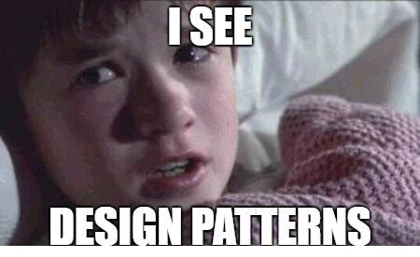
Design Patterns
03

Slide 8

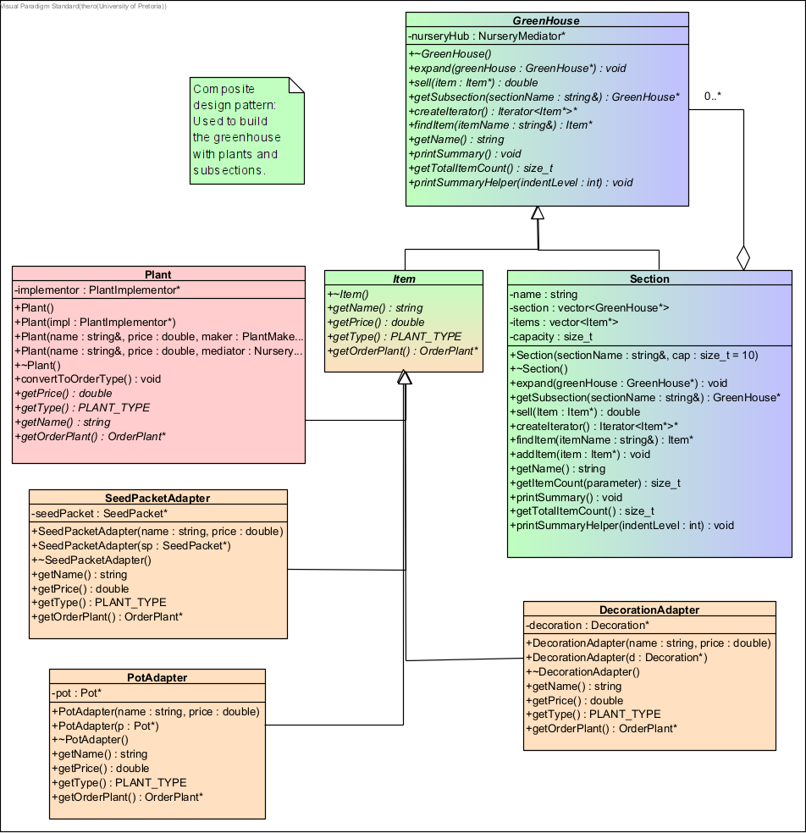
Composite Pattern for Structure
Hierarchical Greenhouse Structure
GreenHouse → Sections → Items
Component Classes
GreenHouse = Component
Section = Composite
Item = Leaf
Benefits
Group plants by type
Easy management
Pattern Integration
Works with Iterator to traverse items

Slide 9
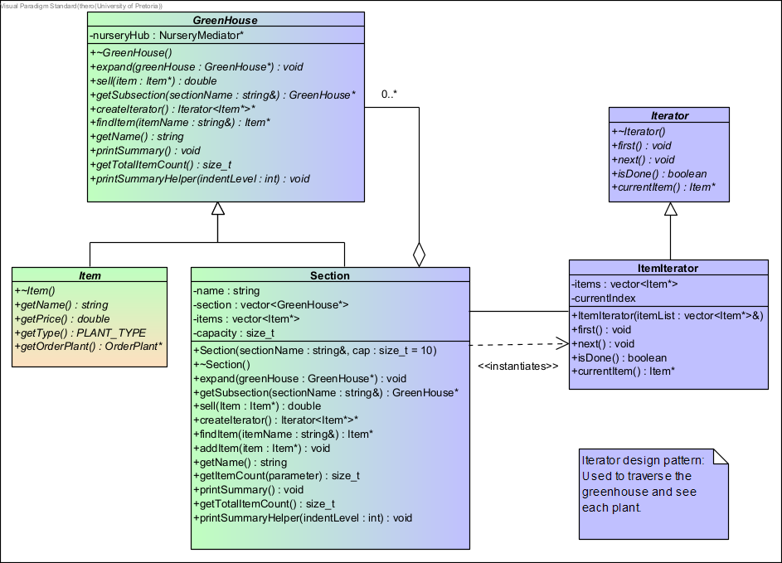




Iterator for Content Traversal
Uniform Access Method
Traverse all items without knowing structure
Navigation
Move across nested sections easily
Encapsulation Benefit
Structure hidden, items accessible

Slide 10
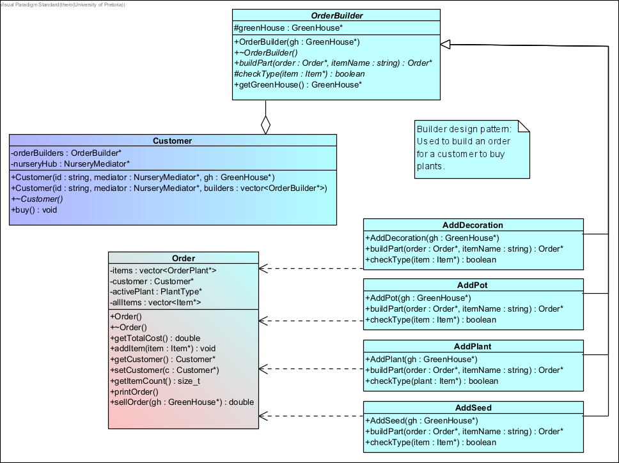




Builder for Order Construction
1
Step-by-step
Build orders part by part
2
Multiple Builders
AddPlant, AddPot, AddSeed, AddDecoration
3
Customizable
Personalized plant packages
4
Clean Logic
Simple interface, complex work hidden

Slide 11




Customer Order Processing
Builder Pattern
Decorator Pattern
Constructs complex orders step-by-step, simplifying creation of customizable customer orders.
Adds optional features to plants, enabling customization with pots and decorations in orders.
Order Components
Sales Command
Includes plants, seeds, pots, and decorations that can be combined into unique customer purchases.
Decouples order requests from execution, allowing staff to process customer orders efficiently.

Slide 12
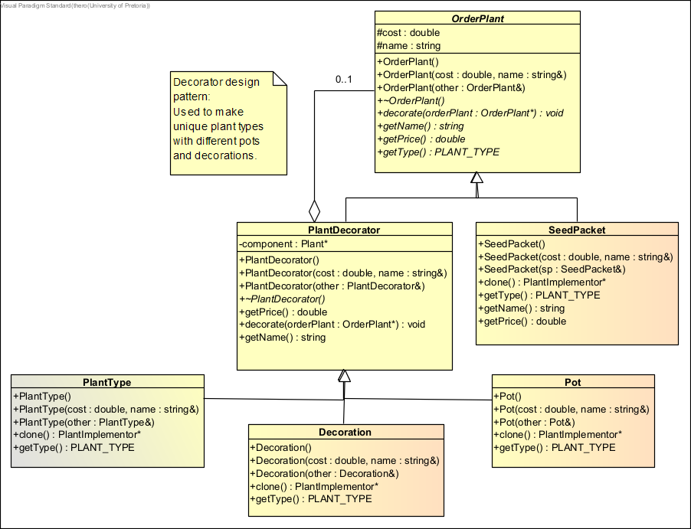
Decorator for Plant Customization
Optional Features Addition
Pots & decorations for unique plants
Component Structure
OrderPlant + PlantDecorator + concrete decorators
Flexibility
Customize without editing plant classes
Price Composition
Base price + add-ons

Slide 13




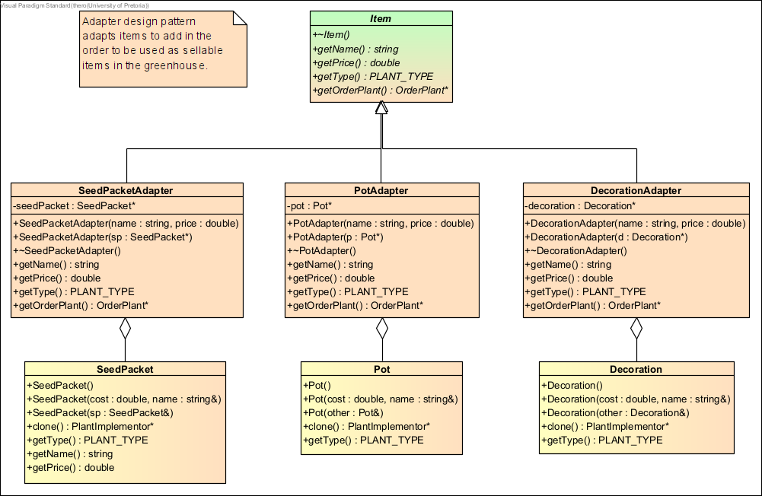
Adapter for Item Integration
Diverse Item Integration
Pots, seeds, decorations as Items
Adapter Classes
SeedPacketAdapter, PotAdapter, DecorationAdapter
Reusability
No need to change existing classes
Unified Interface
Standard “Item” operations

Slide 14
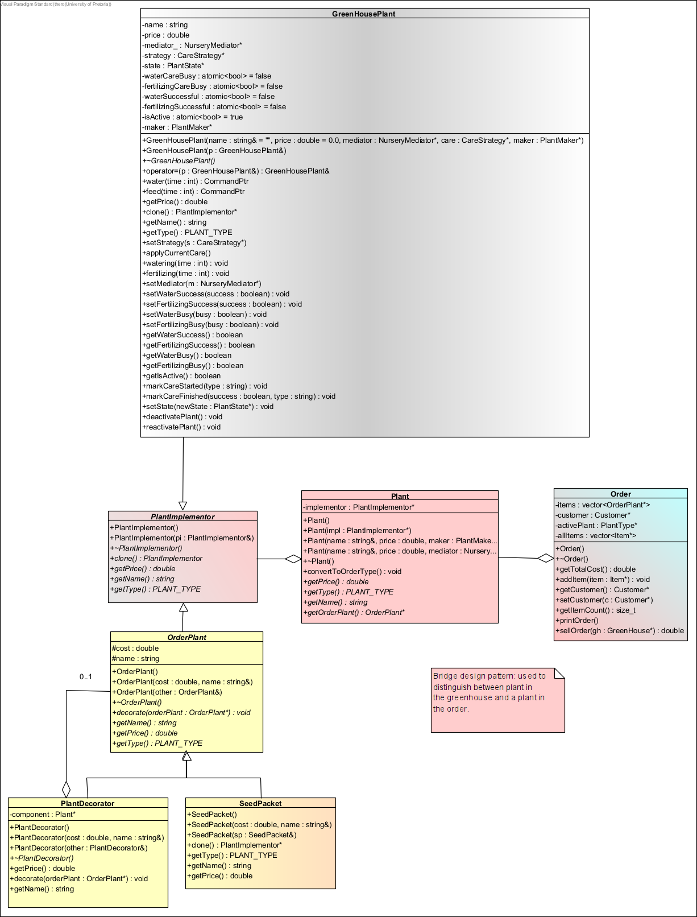




Bridge Pattern for Representation
1
Separation
Greenhouse plants ≠ Order plants
2
Key Classes
Plant, PlantImplementor
GreenHousePlant, OrderPlant
3
Flexibility
Update representations independently
4
Benefit
Less coupling

Slide 15
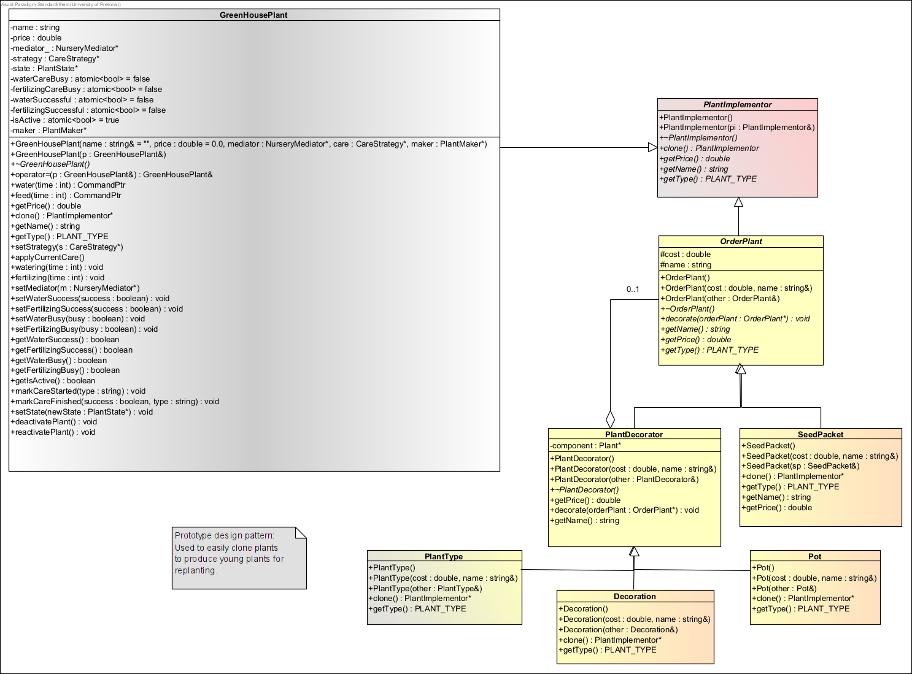
Prototype for Plant Cloning
Clone Plants
Make new plants efficiently
Multiple Prototypes
PlantType, Decoration, Pot, SeedPacket
Reduced Overhead
Avoid recreating objects from scratch
Reusable Templates
Consistent properties for same types

Slide 16
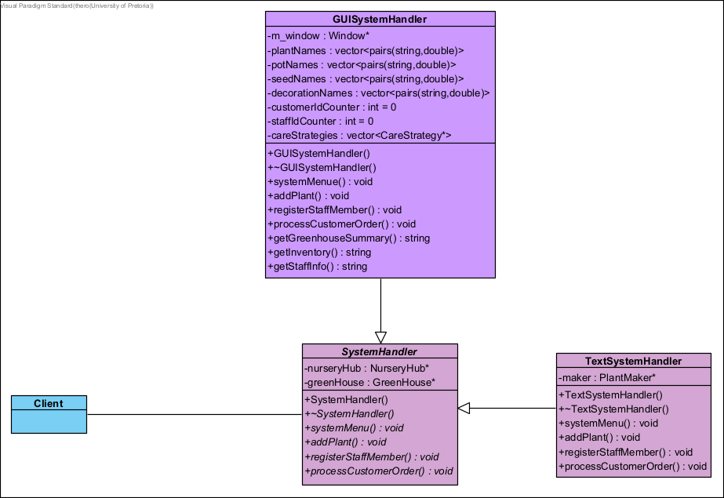
Facade Pattern
Simplifies use for clients
Hides system complexity
behind simple functions
GUISystemHandler provides
a unified interface
Wraps complex subsystem calls
(orders, plants, staff, inventory)

Slide 17
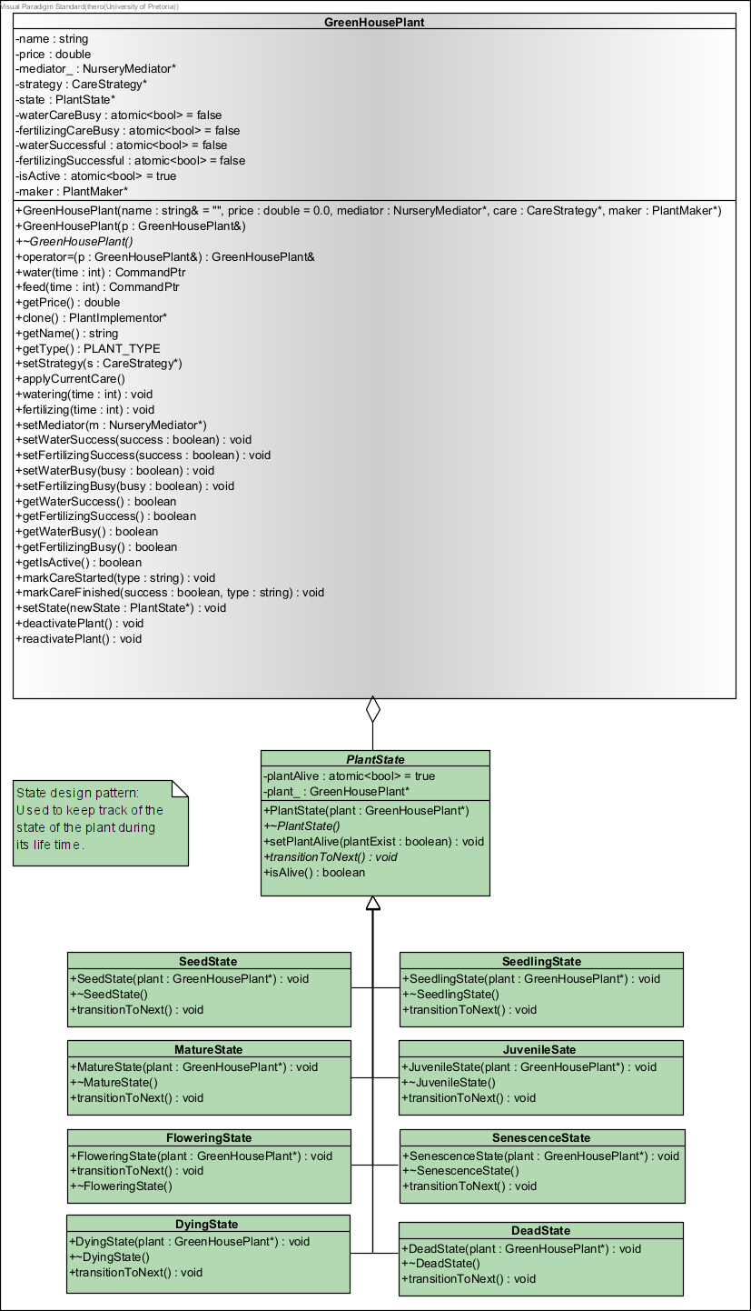

State Pattern for Growth
8 growth states
Plant Lifecycle
Progress based on time & care
Dynamic Changes
Separate classes for each state
Clear Representation
No overly complex condition checks
Simplified Transitions

Slide 18
Concurrent Growth Simulation
Real-time plant simulation
Parallel operations
01
Multithreaded architecture models simultaneous plant growth, state transitions, and care requirements.
02
System handles growth timers, scheduled care, and order processing simultaneously for realistic nursery simulation.
Thread safety
Time-based transitions
03
Mediator pattern and careful locking prevent race conditions while maintaining system responsiveness.
04
Plants progress through lifecycle states at different rates, requiring synchronized care actions.

Slide 19
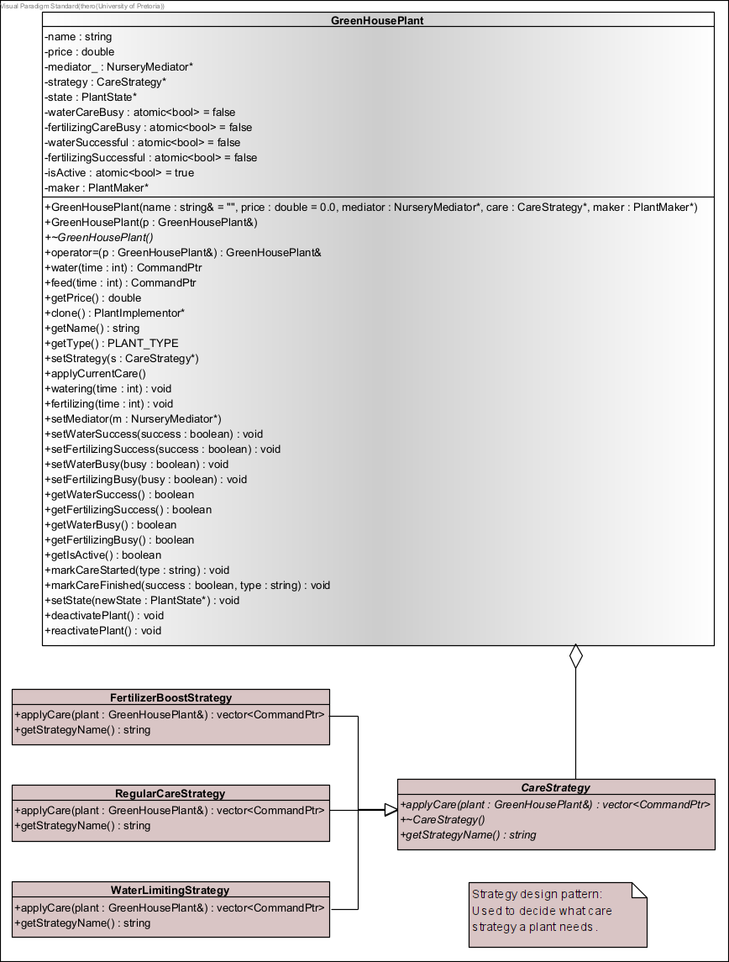
Strategy for Care Requirements
Multiple Strategies
Regular, Boost, WaterLimiting
Flexible
No edits to plant class
Context
GreenHousePlant selects strategy

Slide 20
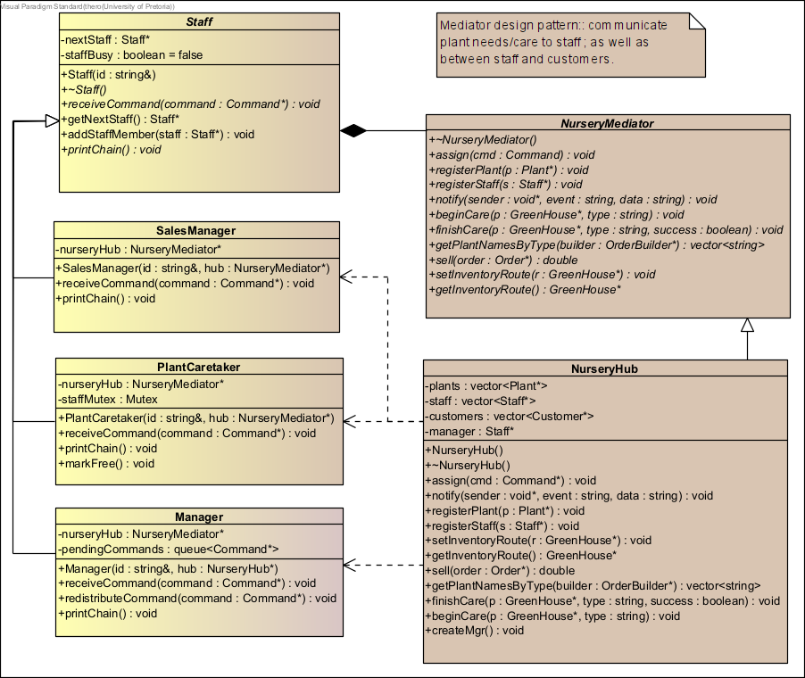
Mediator for Communication
NurseryHub coordinates communication
Central Hub
Staff interact through mediator
Reduces Coupling
NurseryHub, NurseryMediator, PlantCaretaker, SalesManager, Customer, GreenHousePlant
Key Classes
Cleaner interactions between components
Benefits

Slide 21
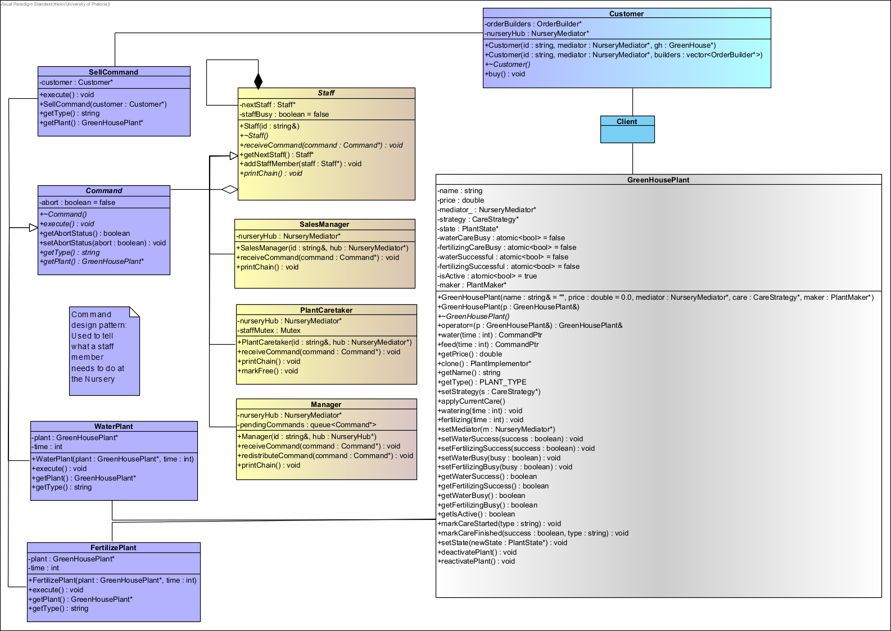
Command Pattern for Tasks
1
Task Execution
Staff trigger commands
2
Key Classes
Staff, Command, WaterPlant, SellCommand, FertilizePlant
3
Receivers
Plants & Customers
4
Benefits
Decoupled logic, easy tracking

Slide 22




Task Assignment System
Command Pattern
Chain of Responsibility
Decouples staff requests from execution, enabling flexible task handling through WaterPlant, FertilizePlant, and SellCommand classes.
Delegates tasks among staff members, allowing SalesManagers and PlantCaretakers to handle appropriate responsibilities.
Mediator Pattern
Staff Hierarchy
Coordinates communication between staff, customers and plants through NurseryHub, reducing direct coupling between components.
Structured system with handlers that process or forward tasks based on role-specific capabilities.

Slide 23
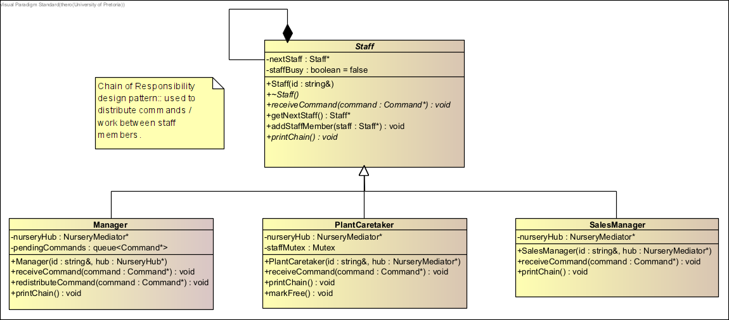
Chain of Responsibility
Task Delegation
Tasks move along staff chain
Handler Classes
Staff, SalesManager, PlantCaretaker, Manager
Staff Hierarchy
Routes based on availability
Benefits
Low coupling, clear workflow

Slide 24
Demo
04

Slide 25
Thanks！

